Slide 1
LLMs in Action: Developing a COM AI Player for an Interactive Tic-Tac-Toe Game using OpenAI Developer API
Lesson 0: Course Overview
Priscilla Emasoga
COM3550 Undergraduate Ambassadors Scheme
University of Sheffield

Slide 2
Background
APIs (Application Programming Interfaces) power the modern web, enabling communication between applications and services. Yet, many students either encounter these concepts only through theoretical lessons or don't see them until very late in their academic journey.
This course provides hands-on with REST APIs, OpenAI's programming interfaces, and client-server architecture. Students will develop the technical skills and understanding needed to build, integrate, and work with APIs—key skills every software engineer needs.
COM3550, Undergraduate Ambassadors Scheme
1/9

Slide 3
Objectives & Prerequisites
What You'll Learn:
How Large Language Models (LLMs) work and how to interact with them via APIs.
We have a pretty cool project coming up!
Fundamentals of REST APIs and how they interact with external systems.
Hands-on experience developing your own APIs using Flask and Python.
Experience with modern web design frameworks, including React and TailwindCSS.
How to connect a backend service (web server) with a frontend application (client)
Prerequisites
Basic understanding of Python, JavaScript, HTML, CSS & Linux
COM3550, Undergraduate Ambassadors Scheme
2/9

Slide 4

$whoami
Priscilla Emasoga
Third year Computer Science student @ University of Sheffield (2020 - 2025)
Incoming Graduate Software Engineer @ Nomura
Research
Predicting signs of cognitive decline from speech using a computerized agent
COM3550, Undergraduate Ambassadors Scheme
3/9

Slide 5
DEMO: Project Overview
COM3550, Undergraduate Ambassadors Scheme
4/9

Slide 6
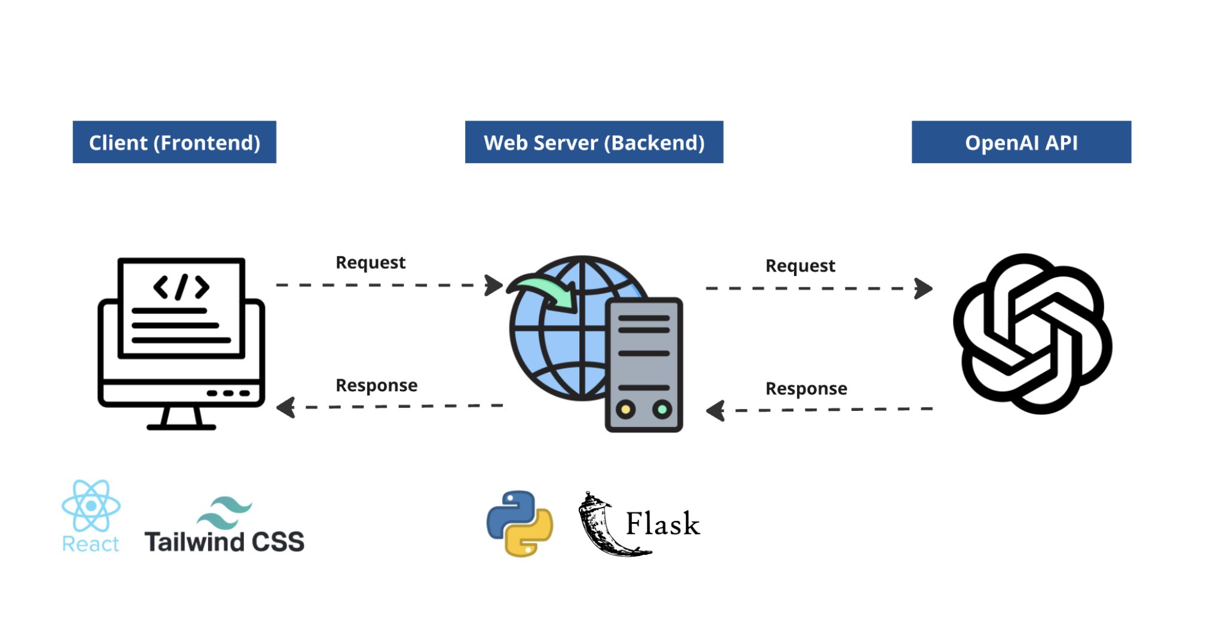
High Level Architecture & Tech Stack
COM3550, Undergraduate Ambassadors Scheme
5/9

Slide 7
Delivery
This course is split into two parts (practical & theoretical):
4 Lessons
To explain high-level concepts
Walk through project code
3 Practical Sessions
Hands on coding sessions
Basic exercises to test your understanding
COM3550, Undergraduate Ambassadors Scheme
6/9

Slide 8
Delivery
Lesson 1 Large Language Models (LLMs)
Motivation: A Brief History of Artificial Intelligence
What is an LLM, Applications & Limitations
Careers in AI
Lesson 2 REST APIs & OpenAI Developer APIs
What is an API?
REST APIs
OpenAI Developer APIs
Practical 1: Introduction to Rest APIs
Lesson 3 Building Modern Web Servers with Flask
What is Flask?
DEMO: The Tic-Tac-Toe AI Web Server
Best Practices
Practical 2: Restful API Development with Flask
COM3550, Undergraduate Ambassadors Scheme
7/9

Slide 9
Delivery
Lesson 4 Frontend Development with React
What is React?
Key Concepts
DEMO: Tic-Tac-Toe Web Client
Practical 3: Introduction to React & TailwindCSS
COM3550, Undergraduate Ambassadors Scheme
8/9

Slide 10
Evaluation
Your Performance in Practical Sessions
End of Project Multiple Choice Quiz
Anonymous Feedback Surveys
COM3550, Undergraduate Ambassadors Scheme
8/9

Slide 11
Questions?
COM3550, Undergraduate Ambassadors Scheme
9/9

